Slide 1
“Russian Tizen” project
April , 2016
Marat Guriev GR Director Samsung Electronics Rus Company

Slide 2
1
Introduction
Tizen experiences explosive growth as #1 platform for IoT
It became a leading independent open platform for all segments
IoT interoperability is the key for rapid growth of Digital Economy
Tizen is guided by Open InterConnect Consortium
Tizen itself is establishing as an Open Independent Project

Slide 3
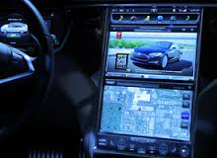
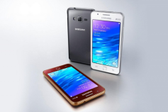
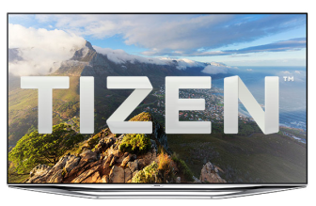
Tizen became the world’s #1 “OS for Everything”
Explosive growth in all categories – emerging to #1 IoT Digital Platform
2014
2015
2016
#1 IoT
11M Mobiles
#3 Mobile
25M TVs
#1 TV
5M Wearable
#2 Wearable

Slide 4
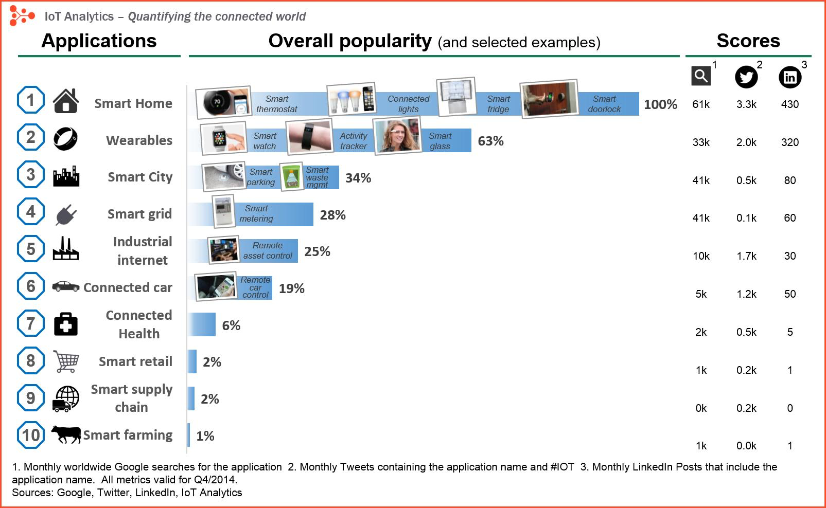
IoT is rapidly emerging in all areas

Slide 5
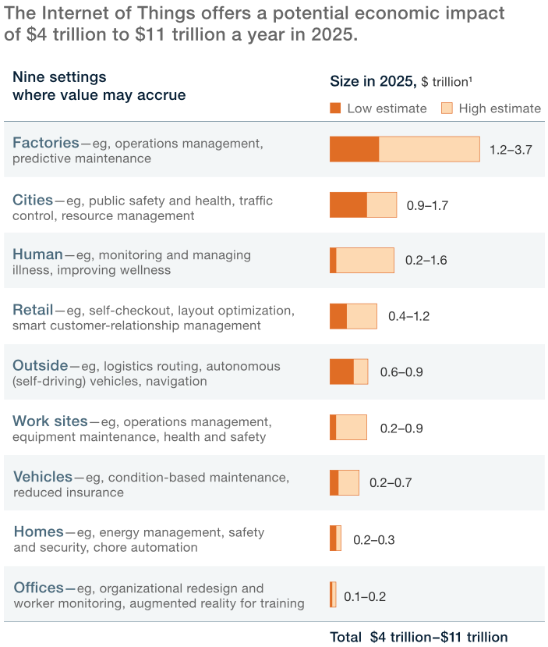
Internet of Things gives birth to the Digital Economy
Achieving this kind of impact would require certain conditions to be in place, notably overcoming the technical, organizational, and regulatory hurdles. In particular, companies that use IoT technology will play a critical role in developing the right systems and processes to maximize its value. Among our findings:
Interoperability between IoT systems is critical. Of the total potential economic value the IoT enables, interoperability is required for 40 percent on average and for nearly 60 percent in some settings.
Currently, most IoT data are not used. For example, on an oil rig that has 30,000 sensors, only 1 percent of the data are examined. That’s because this information is used mostly to detect and control anomalies—not for optimization and prediction, which provide the greatest value.
Business-to-business applications will probably capture more value—nearly 70 percent of it—than consumer uses, although consumer applications, such as fitness monitors and self-driving cars, attract the most attention and can create significant value, too.
The IoT has a large potential in developing economies. Still, we estimate that it will have a higher overall value impact in advanced economies because of the higher value per use. However, developing economies could generate nearly 40 percent of the IoT’s value, and nearly half in some settings.
Customers will capture most of the benefits. We estimate that IoT users (businesses, other organizations, and consumers) could capture 90 percent of the value that IoT applications generate. For example, in 2025 remote monitoring could create as much as $1.1 trillion a year in value by improving the health of chronic-disease patients.
A dynamic industry is evolving around IoT technology. As in other technology waves, both incumbents and new players have opportunities. Digitization blurs the lines between technology companies and other types of businesses; makers of industrial machinery, for example, are creating new business models by using IoT links and data to offer their products as a service.
The new Digital Economy is emerging – based on rapid development of Internet of Things
Companies that use IoT technology will play a critical role in developing the right systems and processes to maximize its value. McKinsey findings:
Interoperability between IoT systems is critical. Of the total potential economic value the IoT enables, interoperability is required for 40 percent on average and for nearly 60 percent in some settings.
Most IoT data are not used. For example, on an oil rig that has 30,000 sensors, only 1 percent of the data are examined. That’s because this information is used mostly to detect and control anomalies—not for optimization and prediction, which provide the greatest value.
Business-to-business applications will probably capture more value - nearly 70 percent of it—than consumer uses, although consumer applications, such as fitness monitors and self-driving cars, attract the most attention and can create significant value, too.
The IoT has a large potential in developing economies. Still, we estimate that it will have a higher overall value impact in advanced economies because of the higher value per use. However, developing economies could generate nearly 40 percent of the IoT’s value, and nearly half in some settings.
Customers will capture most of the benefits. We estimate that IoT users (businesses, other organizations, and consumers) could capture 90 percent of the value that IoT applications generate.
A dynamic industry is evolving around IoT technology. As in other technology waves, both incumbents and new players have opportunities. Digitization blurs the lines between technology companies and other types of businesses (Uberisation)

Slide 6
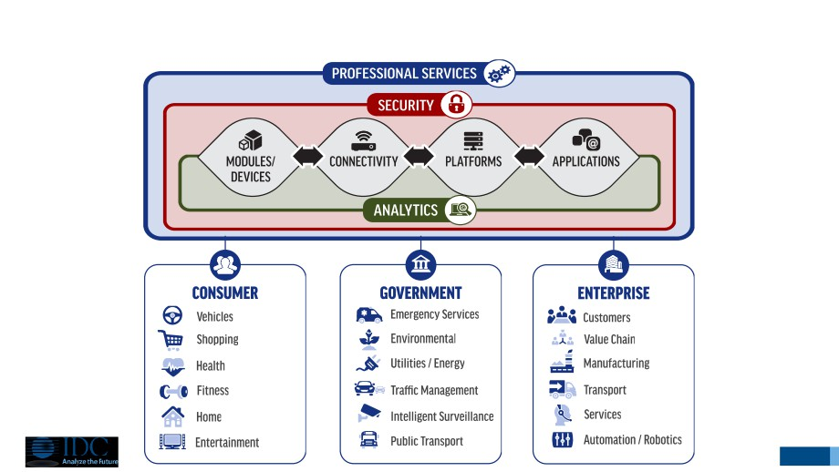
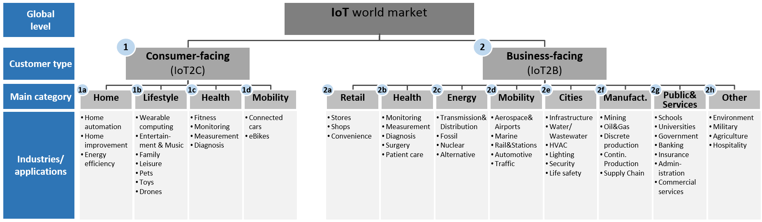
IoT Interoperability – Open InterConnect Consortium
Tizen is developed as a common IoT platform for OpenInterConnect – across all markets

Slide 7
Independent Open Digital Service Platform for IoT
Tizen is an independent open platform for Digital Services
BlueZ
Linux
EFL
BLINK
Open Source & Standard based
Open Source Project
under the Linux Foundation
“The OS of Everything”
Interoperability between IoT systems (IoTivity)
Open Service Platform for Internet-of-Things
Digital Independence
Customized for End-User and Service Provider
Trustworthy (FSTEK, FSB certified)
Convergent – Multiple Device Profiles (TV, Mobile, Watches, etc)
Media
Mobility
IT
M2M
B2G
Government Electronic Services
Trusted Services: Safety, Healthcare
Smart Cities, Smart Infrastructure
B2B
Electronic Services
Industrial Solutions: Transport, Retail, Logistics, Fintech
Enterprise Cloud Platform (SaaS)
B2C
Trusted Services: Safety, Medicine, Finance
Consumer: Transport, Retail, Logistics
InfoTainment: Search, Info, Games, Video, Music

Slide 8
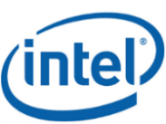
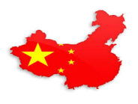
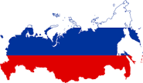
Tizen is a platform for Digital Independence
Tizen develops as Independent Open Platform – getting focused on BRICS country requirements
Linux Foundation Collaborative Project
(Technical Steering Group)
2016
Tizen Project Incorporated
Collecting platform requirements
Platform Development
Defining platform features
Making Roadmap, Release Plan
Platform Release
Defining Device Profile/Compliance
Hosting Developer Conferences
Operating Web Sites
Board of Directors
Compliance/
Certification
Committee
Technical
Steering
Committee
Marketing
Committee
Work Groups
Tizen Association
(Business Partner Ecosystem)
Requrements&Industry
Platform/SDK Dev
Architecture
Program Management
Board
Advisory
Ecosystem
System&Infrastructure
Collecting business requirements
Operation Compliance Program
Issuing Certification
Operating partners program
Recruiting partner companies
Special Country Groups
China Group
Russia Group

Slide 9
2
Report - 2015: Launch
Introduction of Tizen at Skolkovo Startup Village
FSTEK Certification
First Tizen B2B smartphone launch - Z3
Tizen.Ru Association
CNEWS “Best IT Platform” Awards

Slide 10
Tizen Platform value proposition for Russia
Globally recognized and growing, …
Tizen Association
…Open, Scalable and Adaptive…
Fully Open OS, No compulsory app, Customization
…Service Platform…
Advanced virtualization container technology
…for Internet of Things…
OIC, Available for Mobile ∙ Wearable ∙ TV ∙ STB ∙ IVI
…which you can trust !
Certification for FSTEK and FSB (KC1/2)

Slide 11
Report – 2015: the Tizen Launch
2014 |  | Q1’15 |  | Q2’15 |  | Q3’15 |  | Q4’15
30.11.-03.12.2014 Tizen VIP visit to Korea
Participants: Almaz Capital, Russian Investment Agency "Invest in Russia", Sphaera, InfoTeCS, ISP RAS, SIS, Informzaschita, NPP, Skolkovo, I.T. Group
Feb.-Oct. 2015 Tizen Mobile Platform development and release
25.03.-24.08.2015 Tizen OS FSTEK certification
25.12.2015
2000 Z3 devices delivery
Jun. - Aug. 2015 Z3 Tizen Smartphone specification development
09.11.2015
Tizen VPN A-release
20.-24.10.2015
Interpolitech
Tizen DEMO to Minister of Internal Affairs
26.06.-13.09.2015 Tizen DEMO development
02.06.-03.06.2015 Skolkovo Startup Village Tizen Announcement
Presentation of Tizen Enterprise Mobility platform
Meeting with Deputy Prime Minister A.Dvorkovich
17.09.2015
InfoForum, MoI Spec-Info Tech.
Tizen platform, Tizen DEMO
16.06.2015
MoD conference (Army 2015)
Round table with Tizen Report
04-06.02.2015 HQ Delegation visit to Russia
Meetings:
1) Deputy Prime Minister A.Dvorkovich
2) Minister of Comm and MassMedia N.Nikiforov, E.Kovnir +10 experts
3) Federal Tax Service M.Mishustin
4) Head of Security Committee of Russian Parliament H.Vakhaev
5) Security Council (Presidential admin) D.Gribkov
6) Russian Venture Company I. Agamirzyan, CEO
08.09.2015
Enterprise Mobile Security Forum
Tizen Presentation
12.11.2015
CNEWS AWARDS
15.10.2015
Enterprise Mobility Forum
1) Tizen Press Launch
2) Signing MoU for 100,000 devices for Gazprom
21.10.2015
REMS
Tizen pres.

Slide 12
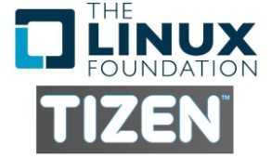
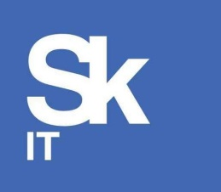
Tizen.Ru Association – the Russian Tizen Ecosystem
Innovation Partners
Academy
Integrators
National
Data
Centers
Information Security
Solution Providers

Slide 13
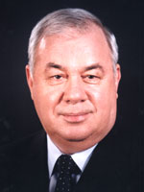
Supervisory Council Chairman - Vladislav Sherstyuk
FAPSI (Federal Agency for Government Communication&Information)
1995-1998 - Head of the Main Control electronic communications intelligence.
Since 1998 - General Director of FAPSI,
Security Council
1998 - member of the Security Council of the Russian Federation.
1999 - 2004 – First Deputy Secretary of the Russian Security Council.
September 2004 - Assistant Secretary of the Security Council of the Russian Federation
Colonel-General in retirement
Candidate of Technical Sciences. Corresponding Member of the Academy of Cryptography of the Russian Federation. Member of the Russian Academy of Natural Sciences (RANS).
Director of the Institute for Information Security Issues at Moscow State University Awards
"For Services to the Fatherland» III and IV,
"Red Banner of Labor",
"Red Star",
Honor, medals. - Honorary member of the KGB.
Honorary Fellow of the federal bodies of governmental communication.
State Awards of the USSR,
Russian Government Prize in the field of science and technology,
Russian Government Prize in the field of education.

Slide 14
3
Plan for 2016: “Russian Tizen”
Building Russian Tizen - Russian Security Profile
Build new Economy of Russian Electronic Services
Government and Enterprise Market
Operator-centered business
Join International Marketplace
Skolkovo Tizen Development Center
IoT Digital Services Center

Slide 15
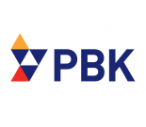
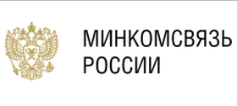
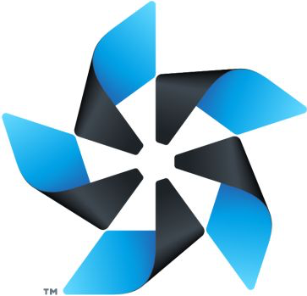
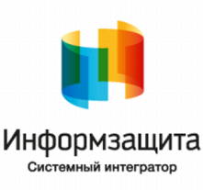
Building Russian Tizen (Security Profile)
Adopt Tizen to the highest Russian Security Standards (FSTEK Class 4)
Innovation
Regulatory compiance
Government
Requirements
Russian Security Profile
+
=
FSTEK Class 6
FSTEK Class 4 (Highest)
Support
Development
Applications
Contributors

Slide 16
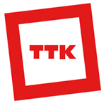
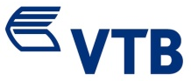
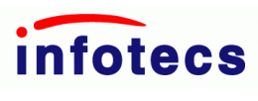
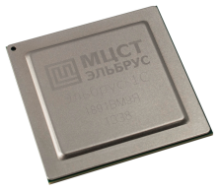
We are building new Russian Value Chain for Electronic Services
Together with our Tizen.Ru partners we will build the new segment of Russian Economy
Building Russian Tizen
Solution Portfolio
Operator AppStores
Markets/Industries
Russian Tizen
B2G
B2B
Tizen Development Center
Russian Security Profile
B2C

Slide 17
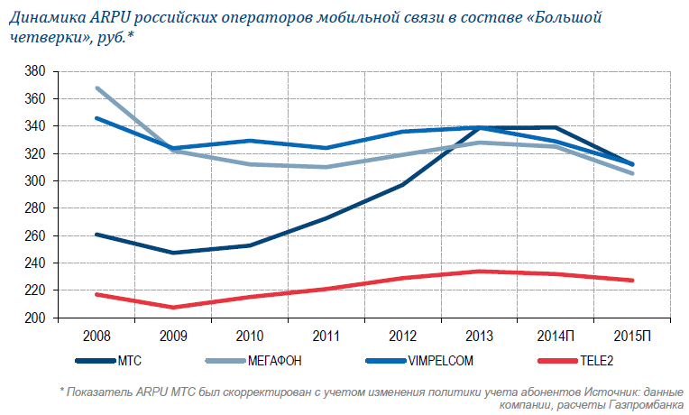
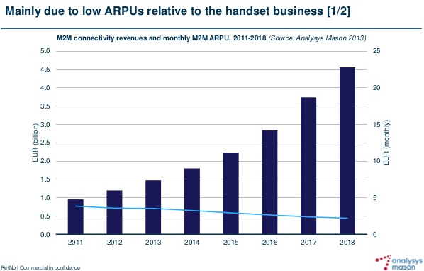
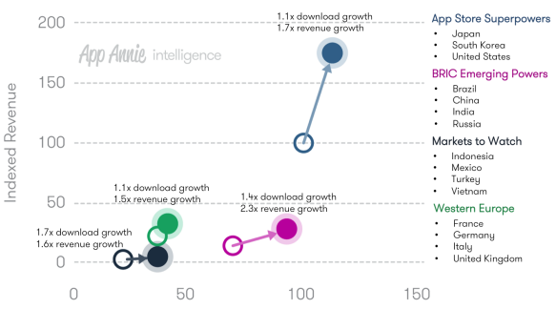
Benefits: Operators entering Digital Services
Tizen allows operators to capture Digital opportunity by implementing their AppStores
Mobile/Broadband/M2M ARPU is declining
Digital Services ARPU is Growing

Slide 18
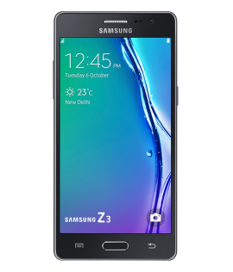
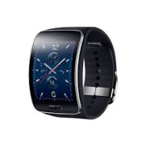
Benefits: Enterprise Economics
Tizen is the best client platform for building the enterprise cloud infrastructure
Enterprise Infrastructure
Benefits
Several Services Levels
Federal Level
Regional Level
City Level
Local Organisation
Integrated Solutions
Partnerships B2B2B/B2B2C
Incremental Business
Financial flexibility (CAPEX/OPEX)
Increase Wallet Share (B2B/B2C)
Incremental Services/Solutions/Applications (Smart School, etc)
Big Data/Analytics
Open Data
Applications (SaaS)
Vertical Applications
Virtual Desktop, VDI
CRM, ERP, SCM, E-mail, Chat
Platforms (PaaS)
Application Environment
Databases, Web Serviers
Security (MDM, VPN)
Application Development
Infrastructure (IaaS)
Virtual servers
Data Storage, Network
Efficiency
Increased employee efficiency
Fraud minimisation
Minimal equipment cost
Impossible “non-targeted use”
Reduce Risks
No “side” and unauthorised applications
Strict Information Policy
Personal data protection
Example – Tizen-based Education Tablet «as a service»: Integrated Solution with preinstalled functionality and applications. Completely controlled from the Cloud. Smart School and Smart Class. Impossible to steal.

Slide 19
Skolkovo Tizen Development Center
Skolkovo Tizen Development Center is designed to become the IoT Digital Services Hub
Investment
Institutes of Innovation
Industry Associations
Strategic/Investment Partners
Skills Levels |  | Development, verification | Architecture, PMO, Advisory | Business Development
Solutions | Industrial | Solution Development | Architecture Development | Business Cases
 | Enterprise
 | Office
Applications | HTML5 | Development and Migration Advisory
 | UX
 | Native |  |  | Prototyping
Platform | AppStore | Education | PMO Advisory
 | MDM/MAM/MIM
 | Security |  |  | Platform Development
Operating System | Security Profile
 | Device Profiles
 | Processors
Technology Partners
Market/Industry Partners
Resource Centers
University Centers
Competence Centers
Development Centers

Slide 20
Target for 2016 – become the IoT leader
We would like to align with governmental priorities and lead the new IoT markets internationally
Develop “Russian Tizen”:
Establish Tizen Development Center
Create Russian security profile
Create development community
Become IoT leader in Russia:
Government, Enterprise and Consumer segments
All existing device profiles
Support domestic platforms
Make Russia the Tizen leader for BRICS countries:
Help Russian developers to enter international markets
Maximize Russian contribution to Tizen Platform

Slide 21
4
Thank you !
We truly appreciate your guidance, insight and comments !

